Slide 1
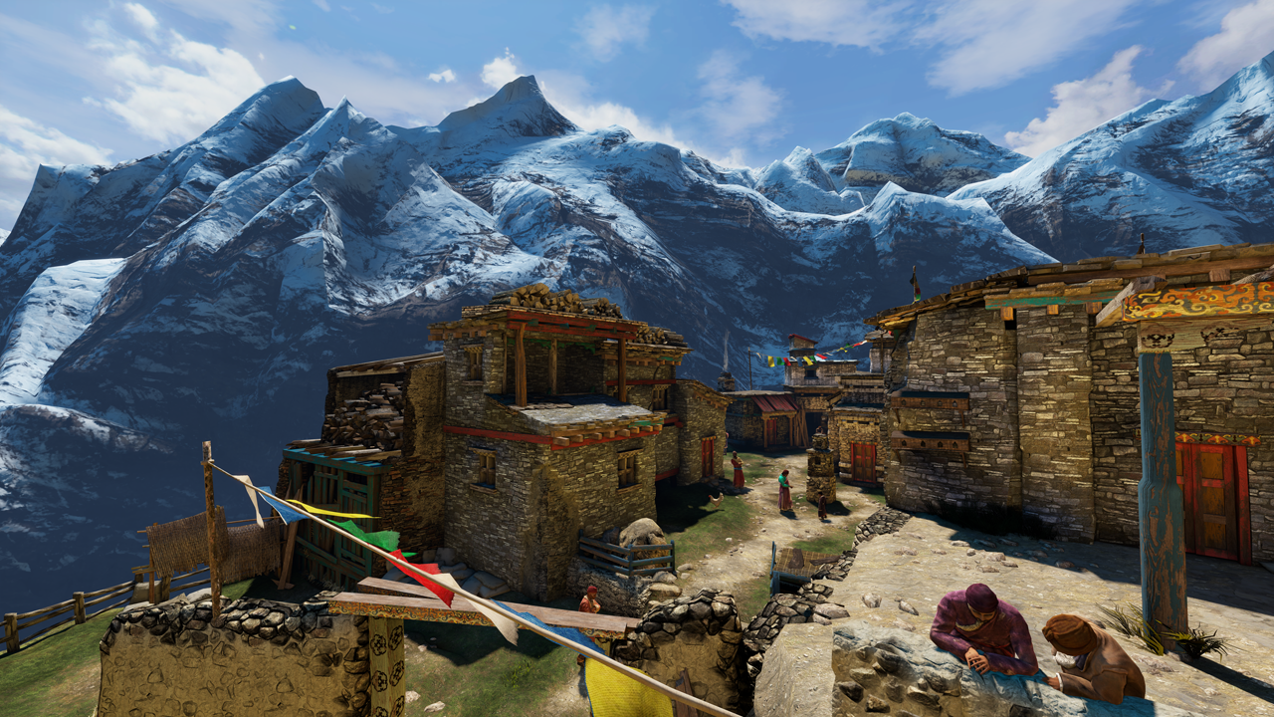
Uncharted 2: HDR Lighting
John Hable
Naughty Dog
Notes:
1
1
1
1
1
1

Slide 2
Agenda
Gamma/Linear-Space Lighting
Filmic Tonemapping
SSAO
Rendering Architecture/How it all fits together.
Notes:
2
2
2
2
2
2

Slide 3
Skeletons in the Closet
Used to work for EA Black Box (Vancouver)‏
Ucap Project
I.e. Tiger Woods's Face
Also used to work for EA Los Angeles
LMNO (Spielberg Project)‏
Not PQRS (Boom Blox)‏
Now at Naughty Dog
Uncharted 2
Notes:
3
3
3
3
3
3

Slide 4
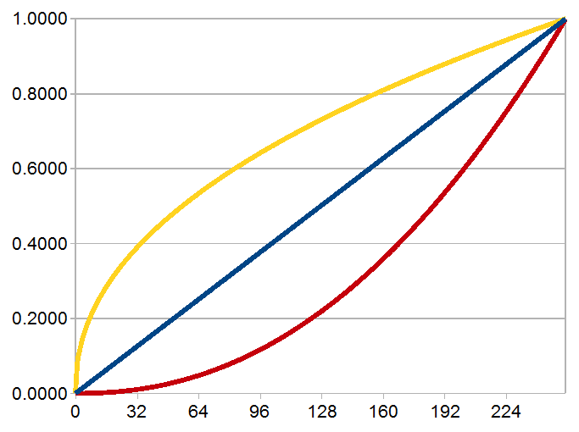
Part 1: Gamma!
Notes:
4
4
4
4
4
4

Slide 5
Gamma
Mostly solved in Film Industry after lots of kicking and screaming
Never heard about it in college
George Borshukov taught it to me back at EA
Matrix Sequels
Issue is getting more traction now
Eugene d’Eon’s chapter in GPU Gems 3
Notes:
5
5
5
5
5
5

Slide 6

Demo
What is halfway between white and black
Suppose we show alternating light/dark lines.
If we squint, we get half the linear intensity.
Notes:
6
6
6
6
6
6

Slide 7
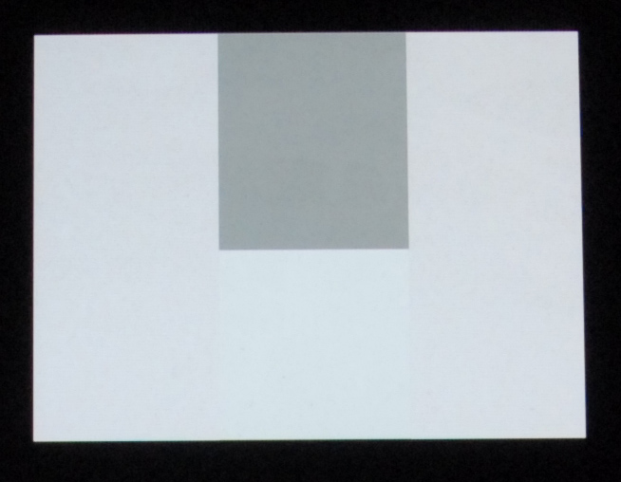
Demo
Test image with 4 rectangles.
Real image of a computer screen shot from my camera.
Notes:
7
7
7
7
7
7
First check out Lines1.png. The left and right side are alternating lines of white and black, so if you step back a few feet, it should look like gray. Notice how the grey box in the middle top is much darker than the left or right, but the middle-bottom box should match pretty closesly. What color is that bottom box?
Now check out Lines2.png. So why is the 187 box about as bright as half of 255?

Slide 8
Demo
Alternating lines of black and white (0 and 255).
Notes:
8
8
8
8
8
8

Slide 9
Demo
So if the left and right are alternating lines of 0 and 255, then what color is the rectangle with the blue dot?
Notes:
9
9
9
9
9
9

Slide 10
Demo
Common wrong answer: 127/128.
That’s the box on the top.
128
Notes:
10
10
10
10
10
10

Slide 11
Demo
Correct answer is 187.
WTF?
128
187
Notes:
11
11
11
11
11
11

Slide 12

Color Ramp
You have seen this before.
0
127
255
187
Notes:
12
12
12
12

Slide 13
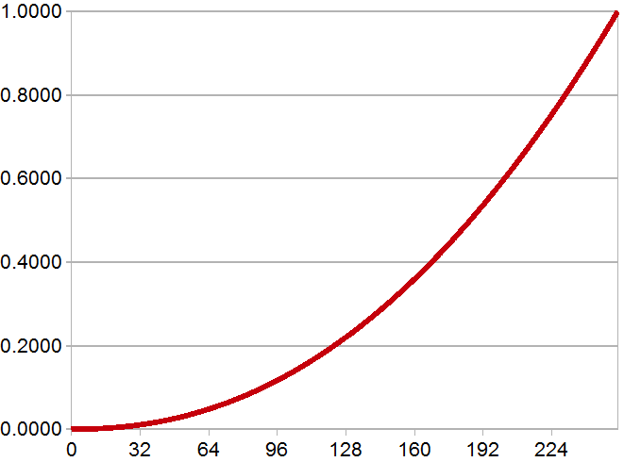
Gamma Lines
255
F(x) = pow(x,2.2)‏
187
127
0
Notes:
13
13
13
13

Slide 14
What is Gamma
Gamma of 0.45, 1, 2.2
Our monitors are the red one
Notes:
14
14
14
14
14
14
Here is what the gamma curves look like, with a power of 1, 2.2, and 0.45, which is about 1/2.2.

Slide 15
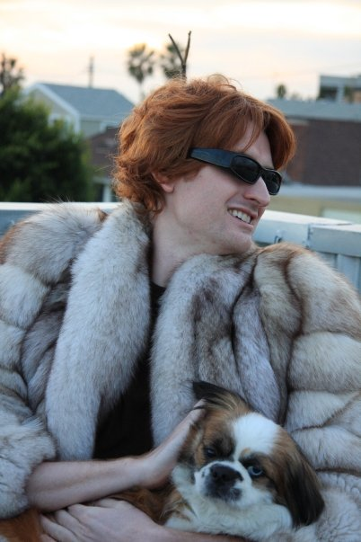
We all love mink...
F(x) = x
Notes:
15
15
15
15
15
15
Here is a liner curve.

Slide 16
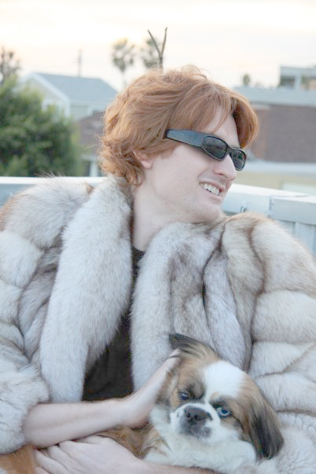
We all love mink...
F(x) = pow(x,0.45) note: .45 ~= 1/2.2‏
Notes:
16
16
16
16
16
16
And a power of 0.45. This looks bright and pastel-ish.

Slide 17
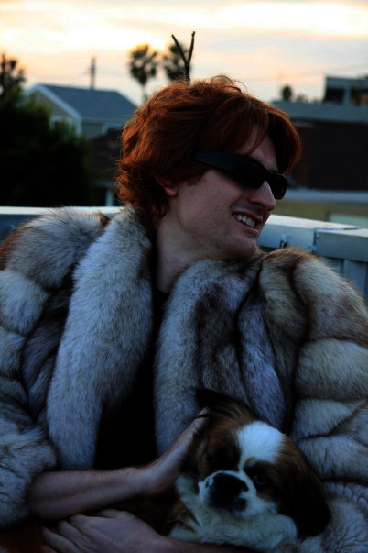
We all love mink...
F(x) = pow(x,2.2)‏
Notes:
17
17
17
17
17
17
And a power of 2.2. This one is dark and contrasty.

Slide 18



What is Gamma
Get to know these curves…
Notes:
18
18
18
18
18
18
That’s what the curves do to images.

Slide 19


What is Gamma
Back and forth between curves.
2.2
2.2
.45
.45
Notes:
19
19
19
19
19

Slide 20

How bad is it?
Your monitor has a gamma of about 2.2
So if you output the left image to the framebuffer, it will actually look like the one right.
2.2
Notes:
20
20
20
20
20

Slide 21
Let’s build a Camera…
A linear camera.
Actual
Light
Monitor
Output
1.0
2.2
Hard
Drive
Notes:
21
21
21
21
21

Slide 22
Let’s build a Camera…
Any consumer camera.
Actual
Light
Monitor
Output
.45
2.2
Hard
Drive
Notes:
22
22
22
22
22

Slide 23
How to fix this?
Your screen displays a gamma of 2.2
This is stored on your hard drive.
You never see this image, but it’s on your hard drive.
2.2
Notes:
23
23
23
23
23

Slide 24
What is Gamma
Curves again.
Notes:
24
24
24
24
24
24

Slide 25
What is Gamma
Q) Why not just store as linear?
A) Our eyes perceive more data in the blacks.
Notes:
25
25
25
25
25
25
A common question I get is: “Why not just store images as linear?”

Slide 26


How bad is it?
Suppose we look at the 0-63 range.
What if displays were linear?
Notes:
26
26
26
26
26

Slide 27
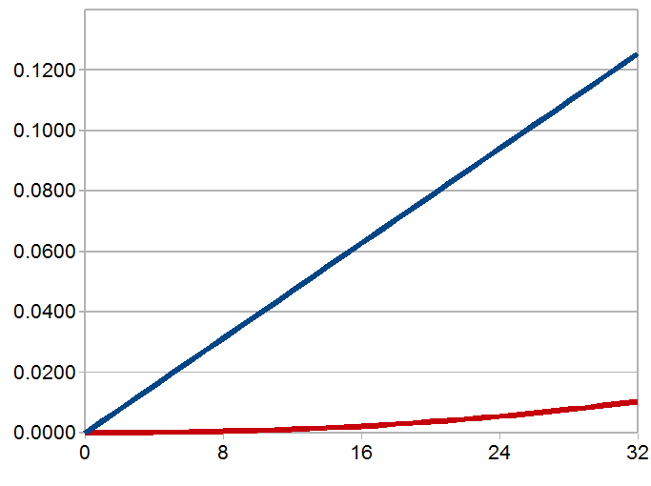
Gamma
Gamma of 2.2 gives us more dark colors.
Notes:
27
27
27
27
27
27
You see, with a gamma of 2.2, we have about 32 shades of brey between 0 and 0.01. But a linear curve only has about 3.

Slide 28
How bad is it?
If displays were linear:
On a scale from 0-255
0 would equal 0
1 would equal our current value of 20
2 would equal our current value of 28
3 would equal our current value of 33
Darkest Values:
Notes:
28
28
28
28
28
28
As it stands, assuming a perfect gamma 2.2, we currently have 19 shades of grey in between black and that first shade of grey. With a linear curve, we have 0. So the gamma curve gets us better blacks at the expense of less precision in the whites.

Slide 29
Ramp Again
See any banding in the whites?
Notes:
29
29
29
29
29
29
But as it stands, our whites look fine, and if anything, the blacks have banding. We could use a linear curve, which would give us terrible banding in the darks, but better precision in the whites, but that would be a horrible tradeoff.

Slide 30
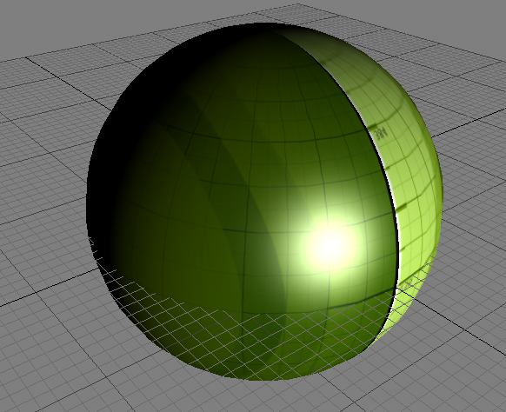
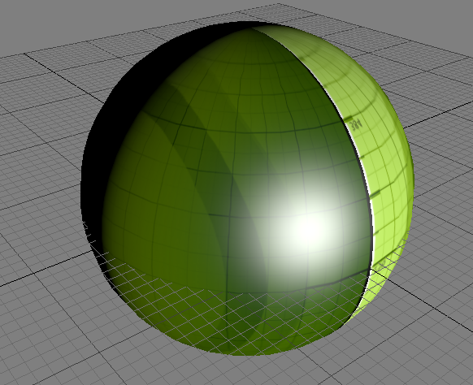
3D Graphics
If your game is not gamma correct, it looks like the image on the left..
Note: we’re talking about “correct”, not “good”
Notes:
30
30
30
30
30
30
Here is the default sphere from FX Composer 1.7. So how does gamma relate to us? Well, if your game does lighting in gamma space, it looks like the image on the left. If you are in linear, it looks like the image on the right. Notice how the specular highlight shifts from white, to yellow, to green-ish, to yellow-ish. Whereas the linear space version looks like a green object with a white specular highlight.

Slide 31
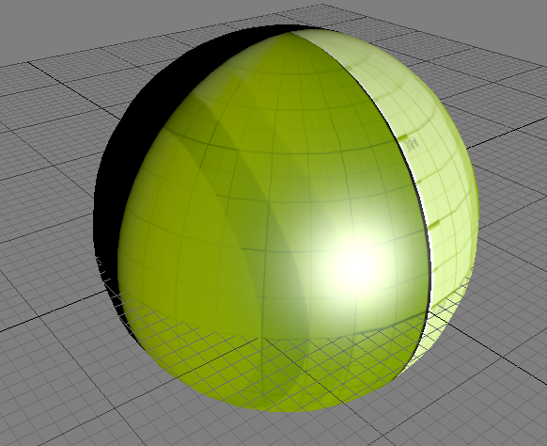
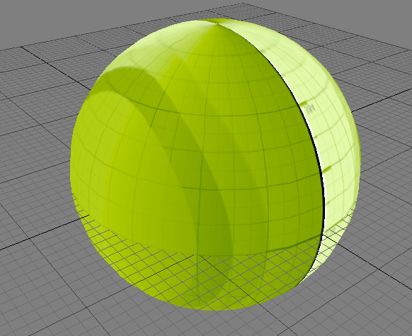
3D Graphics
Here's what is going on.
Hard
Drive
Screen
Lighting
Notes:
31
31
31
31
31

Slide 32
3D Graphics
Account for gamma when reading textures
color = pow( tex2D( Sampler, Uv ), 2.2 )‏
Do your lighting calculations
Account for gamma on color output
finalcolor = pow( color, 1/2.2 )‏
Notes:
32
32
32
32
32

Slide 33
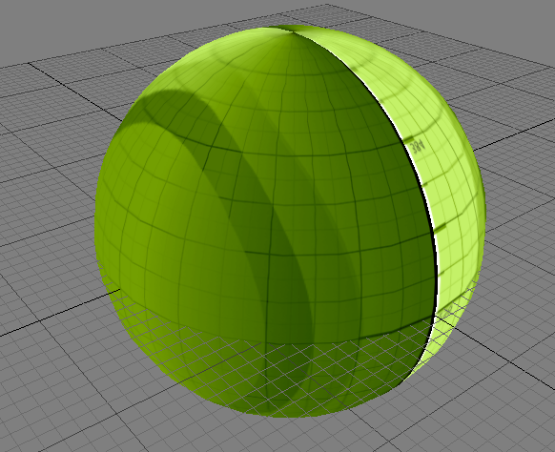
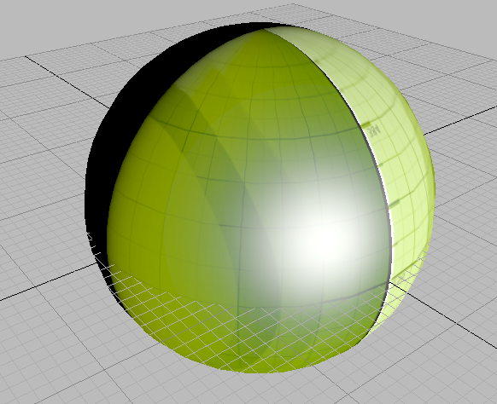
3D Graphics
Here's what is going on.
Monitor
Adjust
Hard
Drive
Lighting
Gamma
Shader
Correct
Notes:
33
33
33
33
33

Slide 34
3D Graphics
Comparison again...
Notes:
34
34
34
34
34
34
Here is the comparison again.

Slide 35
3D Graphics
The Wrong Shader?
Spec = CalSpec();
Diff = tex2D( Sampler, UV );
Color = Diff * max( 0, dot( N, L ) ) + Spec;
return Color;
Notes:
35
35
35
35
35
35
Here is the wrong shader.

Slide 36
3D Graphics
The Right Shader?
Spec = CalSpec();
Diff = pow( tex2D( Sampler, UV ), 2.2 );
Color = Diff * max( 0, dot( N, L ) ) + Spec;
return pow( Color, 1/2.2);
Notes:
36
36
36
36
36
36
And here is the correct shader.

Slide 37
3D Graphics
But, there is hardware to do this for us.
Hardware does sampling for free
For Texture read:
D3DSAMP_SRGBTEXTURE
For RenderTarget write:
D3DRS_SRGBWRITEENABLE
Notes:
37
37
37
37
37
37
But of course we don’t actually want to perform the power 2.2 because it’s expensive. So the hardware vendors made render states to do this conversion for us for free!

Slide 38
3D Graphics
With those states we can remove the pow functions.
Spec = CalSpec();
Diff = tex2D( Sampler, UV );
Color = Diff * max( 0, dot( N, L ) ) + Spec;
return Color;
Notes:
38
38
38
38
38
38
Good bye pow function.

Slide 39

3D Graphics
What does the real world look like?
Notice the harsh line.
Notes:
39
39
39
39
39
39
One common question I get is that artists don’t like the harsh linear falloff…they like the softer falloff better. Well, in the real world, objects have a harsh falloff. And it actually looks awesome if you do it right.

Slide 40
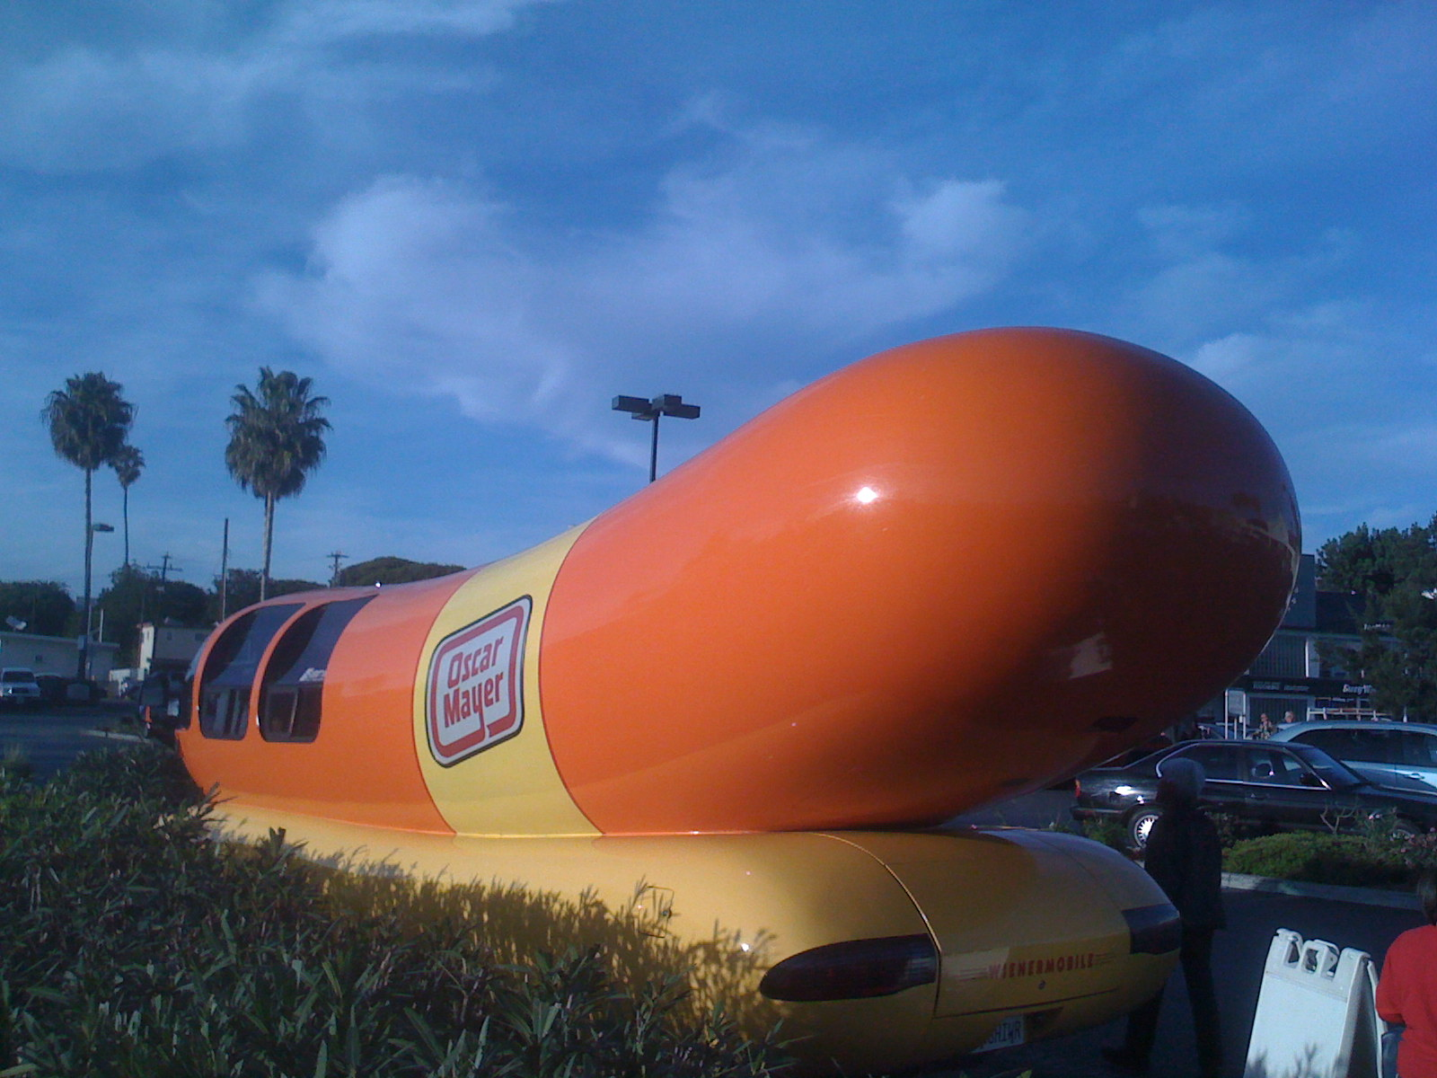
3D Graphics
Another Example
Notes:
40
40
40
40
40
40

Slide 41
FAQs
Q1) But I like the soft falloff!
A1) Don’t be so sure.
Notes:
41
41
41
41
41
41
Also, you are allowed to change the falloff of your shader to something less harsh. In general, I think you shouldn’t, but it’s better than doing everything in gamma space just because you like one side-effect.

Slide 42
FAQs
It looks like the one on top before the monitor’s 2.2
Notes:
42
42
42
42
42
42

Slide 43
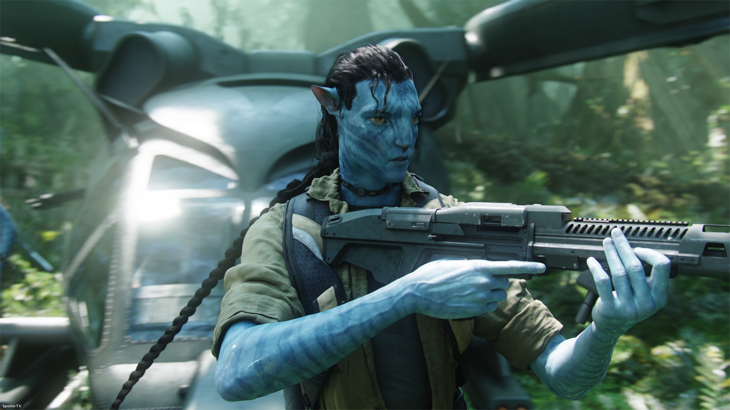
Harsh Falloff
Devastating.
Notes:
43
43
43
43
43
43

Slide 44
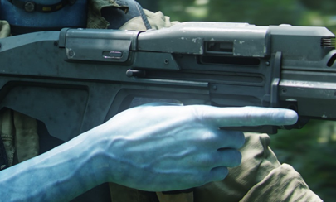
Harsh Falloff
Devastating.
Notes:
44
44
44
44
44
44

Slide 45
Harsh Falloff
Devastating.
Notes:
45
45
45
45
45
45

Slide 46
Which Maps?
Which maps should be Linear-Space vs Gamma-Space?
Gamma-Space
Use sRGB hardware or pow(2.2) on read
128 ~= 0.2
Linear-Space
Don’t use sRGB or pow(2.2) on read
128 = 0.5
Notes:
46
46
46
46
46
46

Slide 47
Which Maps?
Diffuse Map
Definitely Gamma
Normal Map
Definitely Linear
Notes:
47
47
47
47
47
47

Slide 48
Which Maps?
Specular?
Uncharted 2 had them as Linear
Artists have trouble tweaking them to look right
Probably should be in Gamma
Notes:
48
48
48
48
48
48

Slide 49
Which Maps?
Ambient Occlusion
Technically, it’s a mathematical value like a normal map.
But artists tweak them a lot and bake extra lighting into them.
Uncharted 2 had them as Linear
Probably should be Gamma
Notes:
49
49
49
49
49
49

Slide 50
Exercise for the Reader
Gamma 2.2 != sRGB != Xenon PWL
sRGB: PC and PS3 gamma
Xenon PWL: Piecewise linear gamma
Notes:
50
50
50
50
50
50

Slide 51
Xenon Gotchas
Xbox 360 Gamma Curve is wonky
Way too bright at the low end.
HDR the Bungie Way, Chris Tchou
Post Processing in The Orange Box, Alex Vlachos
Output curve is extra contrasty
Henry LaBounta was going to talk about it.
Try hooking up your Xenon to a waveform monitor and display a test pattern. Prepare to be mortified.
Both factors counteract each other
Notes:
51
51
51
51
51
51

Slide 52
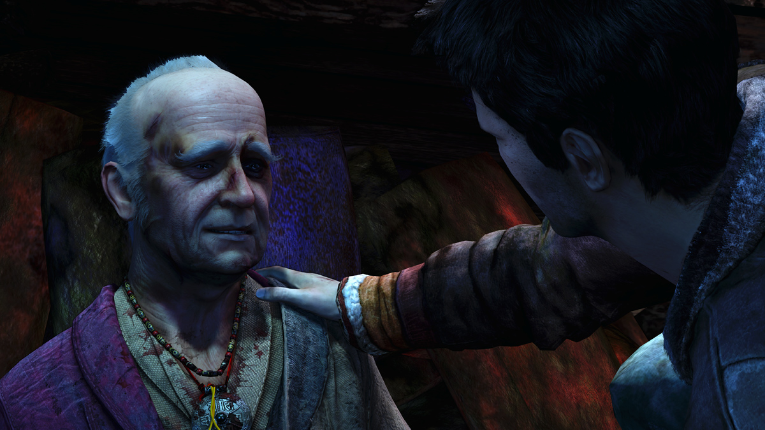
Linear-Space Lighting: Conclusion
“Drake! You must believe in linear-space lighting!”
Notes:
52
52
52
52
52
52

